Slide 1
AWS Overview
Karthick Selvam

Slide 2
AWS Overview
Introduction to AWS, Usage, core concepts such as elasticity, scalability, virtualization
IaaS, PaaS, SaaS
VPC, Subnet, Security Group, NACL, NAT Instance
Overview of DW and Data Lake related services, such as, EMR, Glue, Redshift, Athena
Region, Availability Zone, Edge Locations
IAM user, roles, policies

Slide 3
Virtualization
Karthick Selvam

Slide 4
Topics
What is Virtualization?
Why we need the Virtualization?
Advance concepts of Virtualization?

Slide 5
General Questions
How the System Booting Process will happen?
Why we cant able to boot 2 OS at the Single Hardware?
What is BIOS?
What is Boot Sector?
How system will work after the booting process?

Slide 6
BIOS
BIOS is the program a computer microprocessor uses to start the computer system after it is powered on.
It also manages data flow between the computer OS and attached peripheral devices

Slide 7

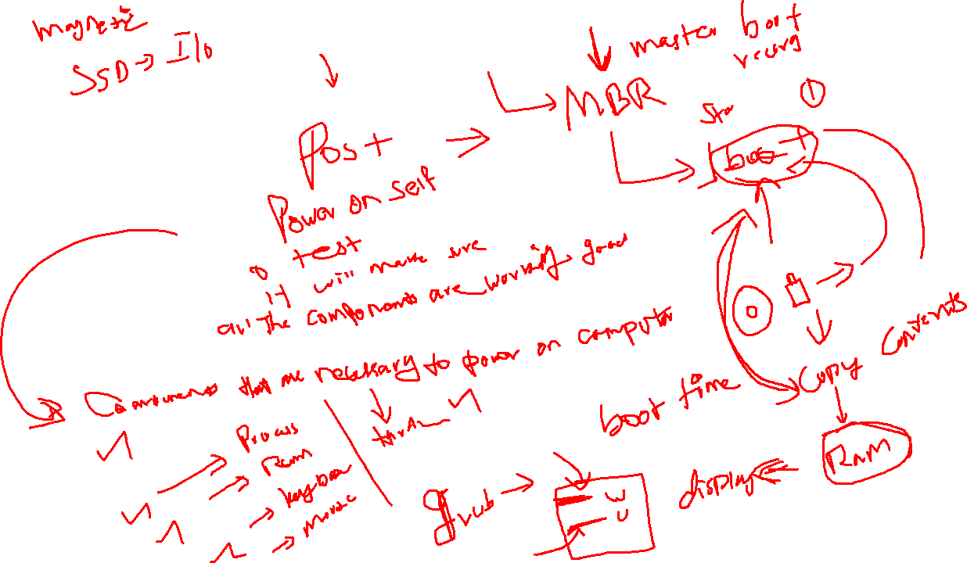

Slide 8
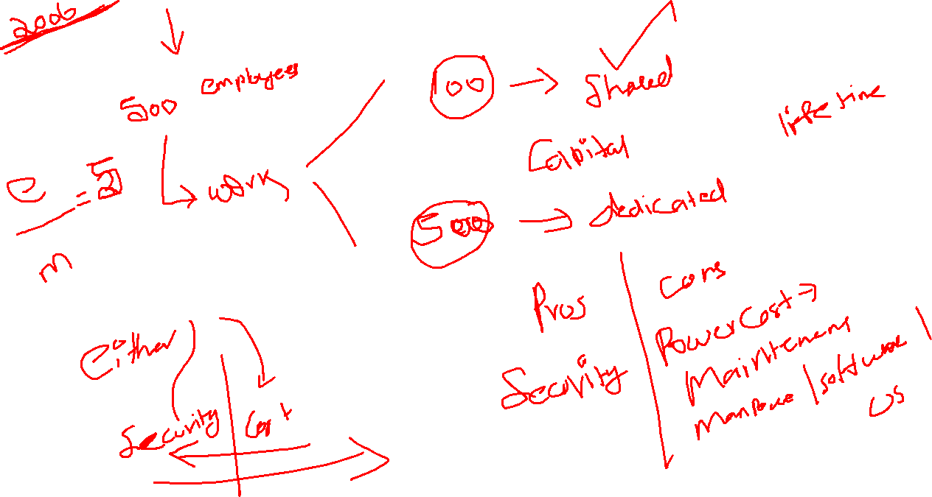
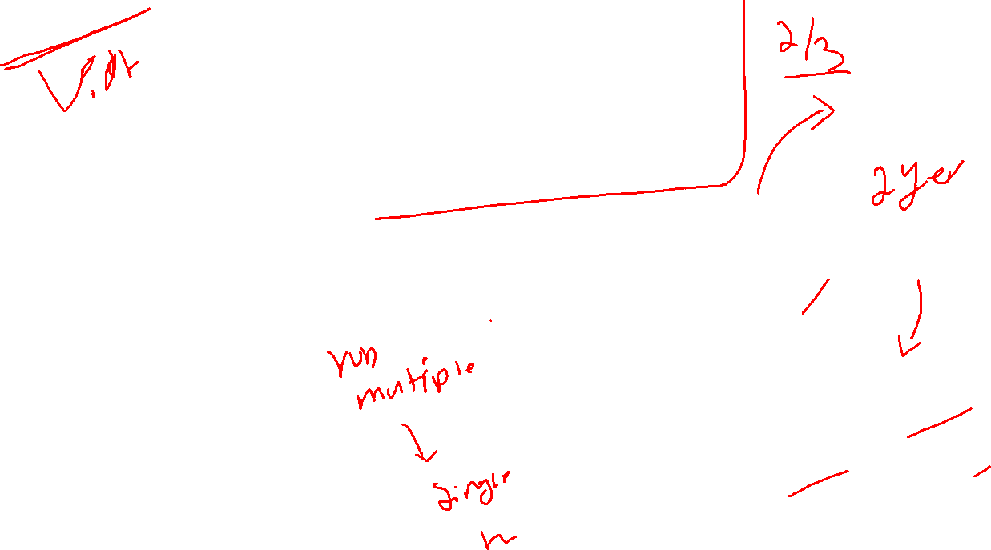

Slide 9
Virtualization
Environment -> your hardware resources into software components and make it manage to install multiple OS at the same time in the Single hardware
Concept of Creating the Software based Fake environment to make the OS to trust all the resources that will be physically available and boot the Multiple OS at the same time.

Slide 10
Types of Virtualization
TYPE 1
TYPE 2

Slide 11
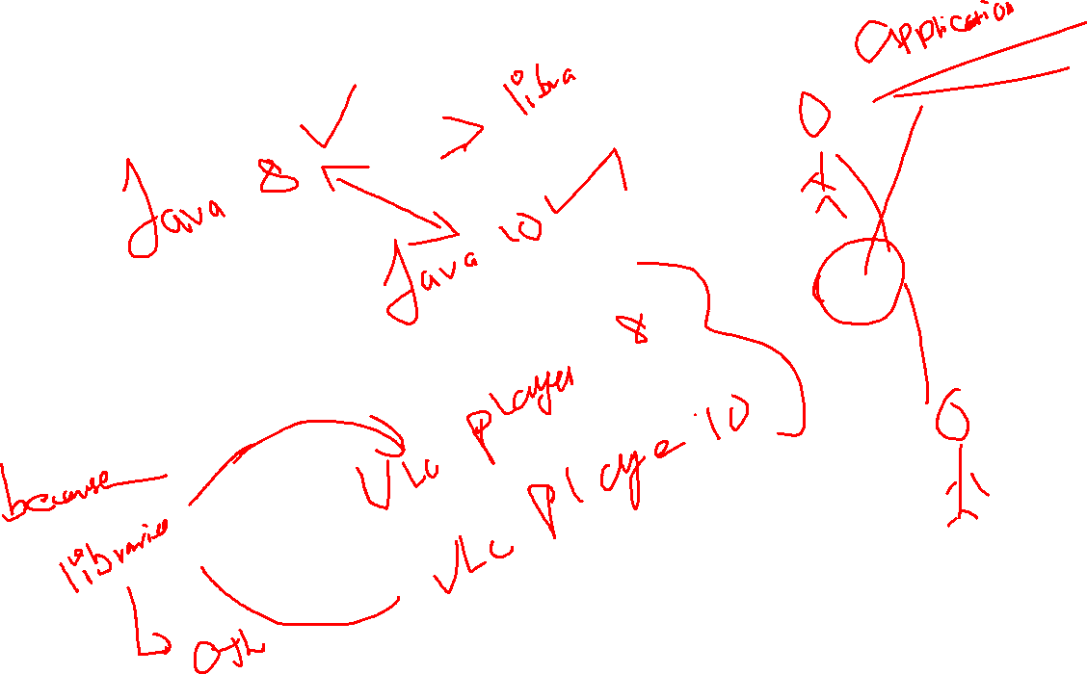

Slide 12
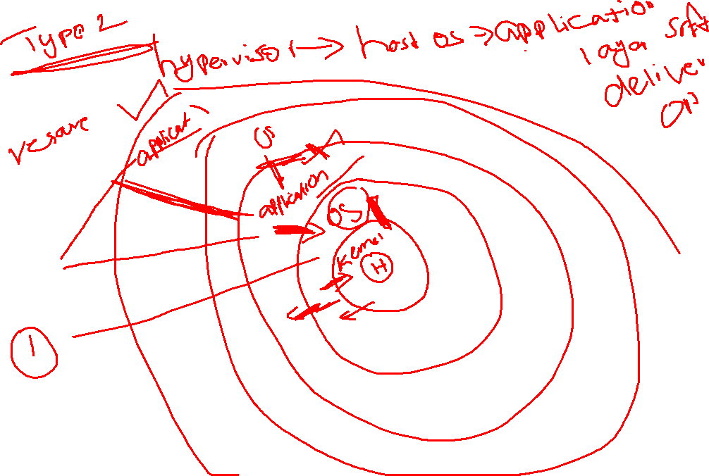

Slide 13
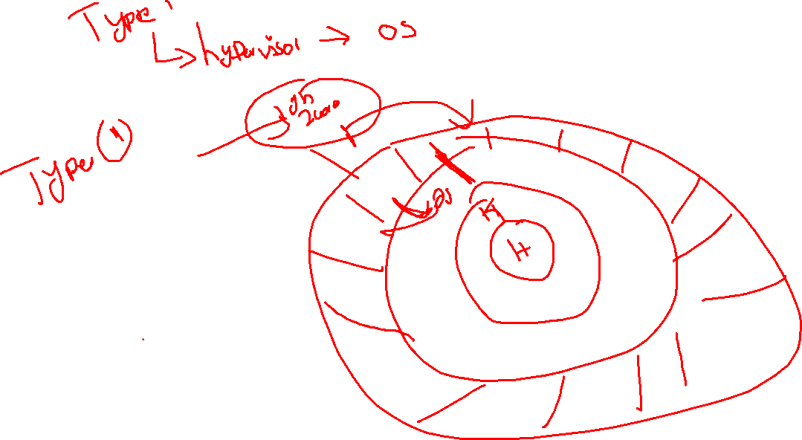

Slide 14
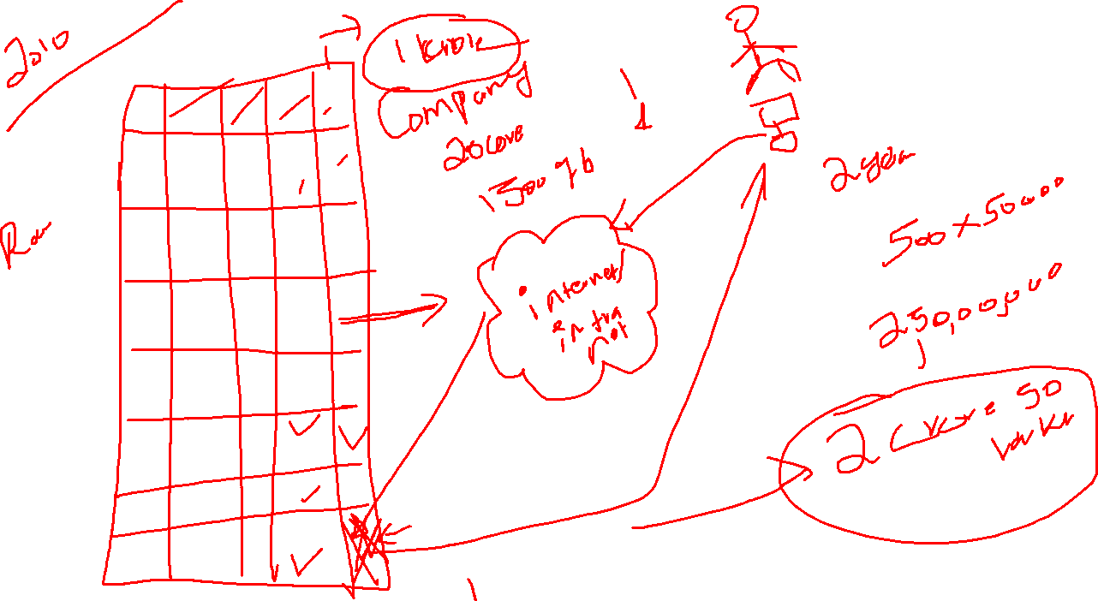

Slide 15
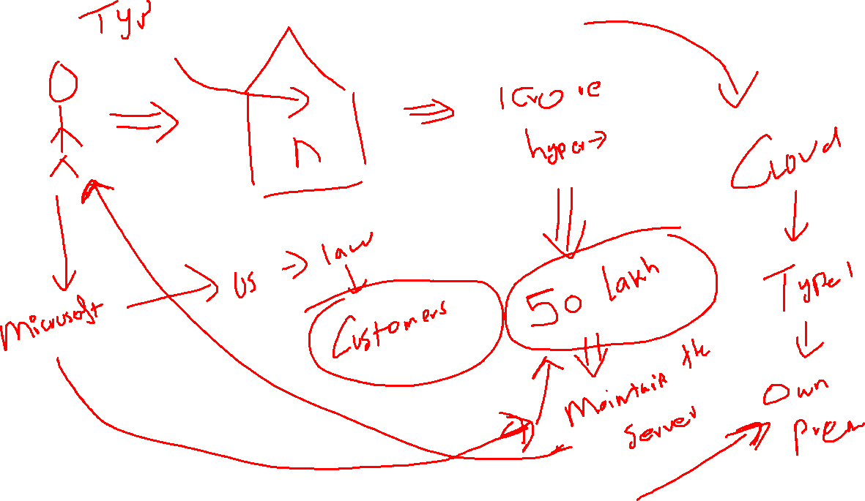

Slide 16
Break time -> 04.30

Slide 17
Introduction to AWS
Karthick Selvam

Slide 18
Cloud Vendors
Google Cloud
Amazon Cloud
Microsoft Azure Cloud
Oracle Cloud
IBM Cloud

Slide 19
Types Cloud
Public Cloud
Private Cloud
Hybrid Cloud
Community Cloud

Slide 20
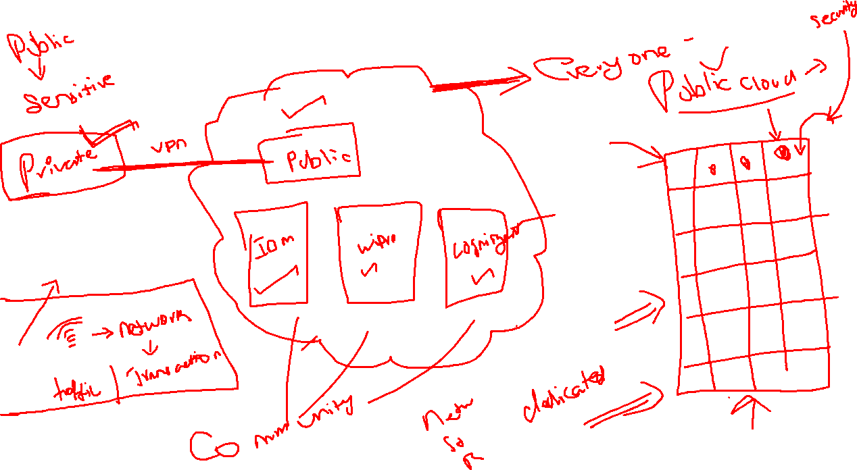

Slide 21
What kind of service that cloud companies will offer?
IAAS ->
CPU + RAM + Network + Storage + OS Template -> Experts, if we maintain the architecture
Cloud Company will be responsible for maintaining only the hardware and networking component
SAAS
Software as rental -> Developing, Compiling, Debugging
Hardware + OS + Security -> Amazon
PAAS
Platform as Service -> interface to access it
Developing, Compiling, Debugging, Hardware + OS + Security -> Amazon

Slide 22
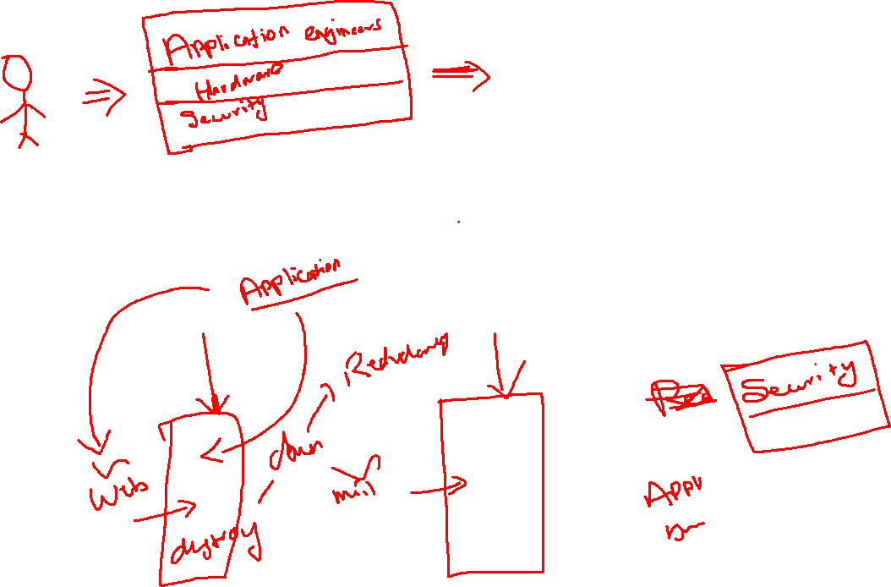
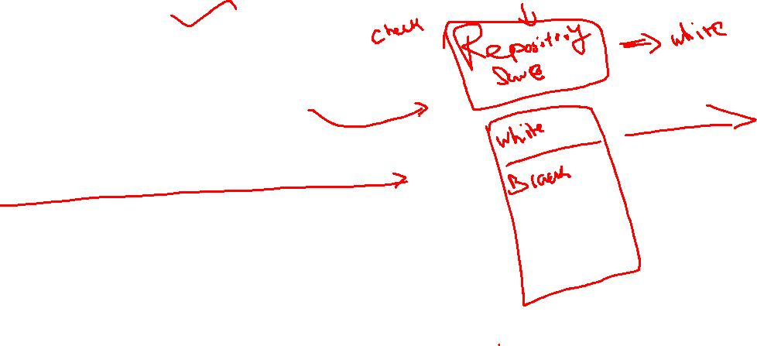

Slide 23
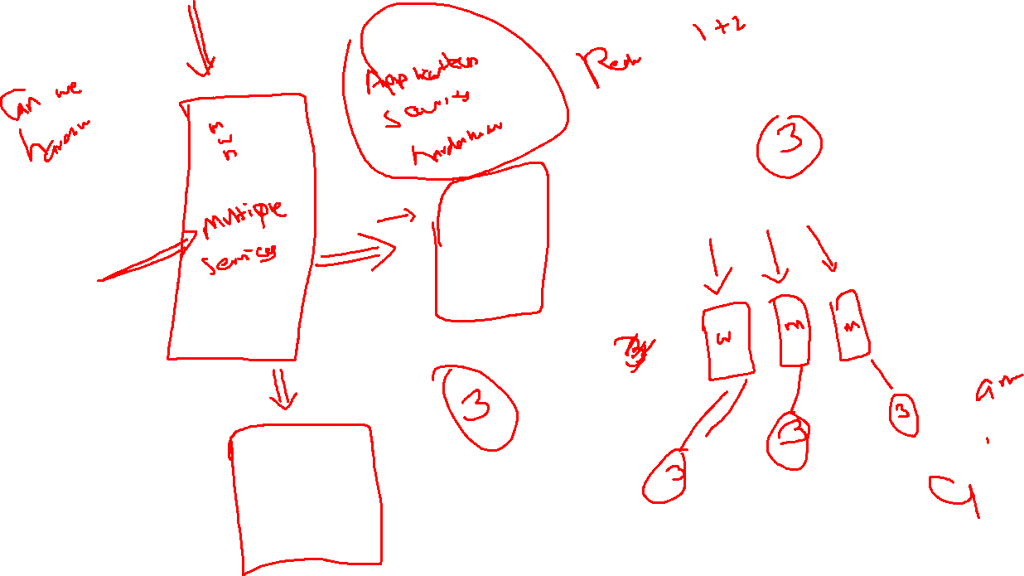

Slide 24
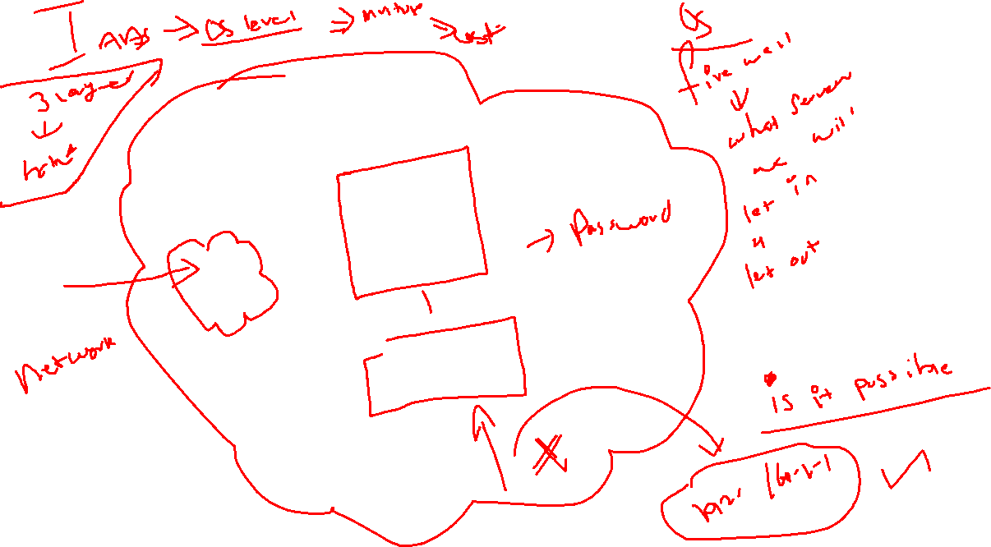

Slide 25
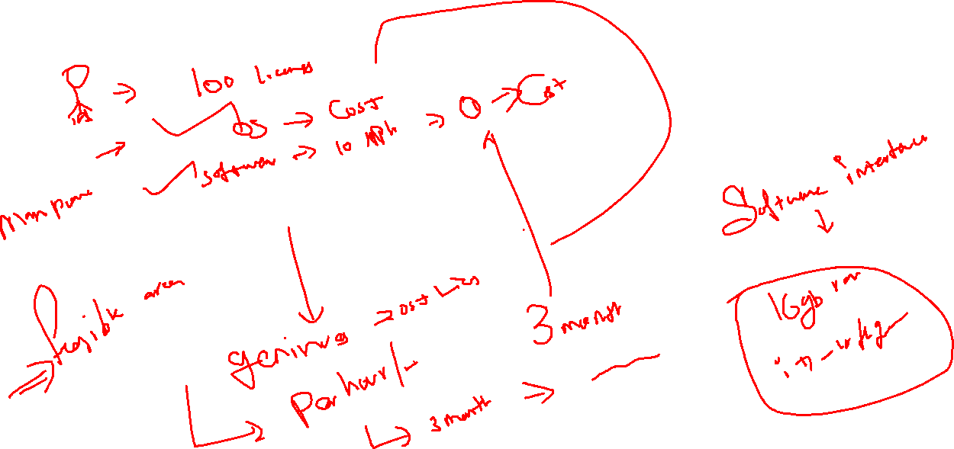

Slide 26
Usage
According to all the cloud vendors, they will charge depends on per hour usage for the services such as
IAAS
SAAS
PAAS
1 hour , 1 sec -> 2 hour bill

Slide 27
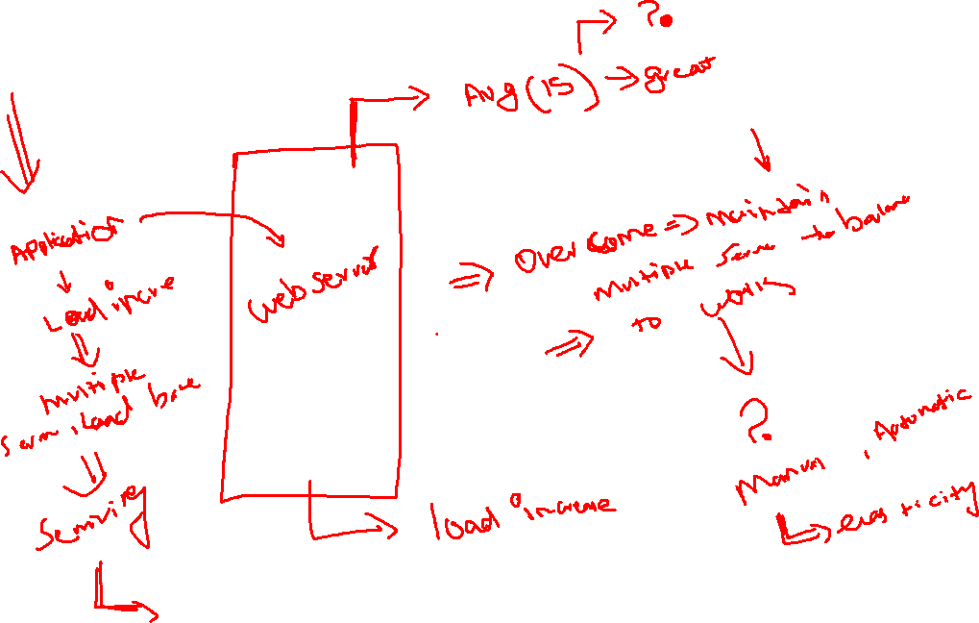
elasticity, scalability

Slide 28
Types of Scalability
Horizontal Scaling
Vertical Scaling

Slide 29
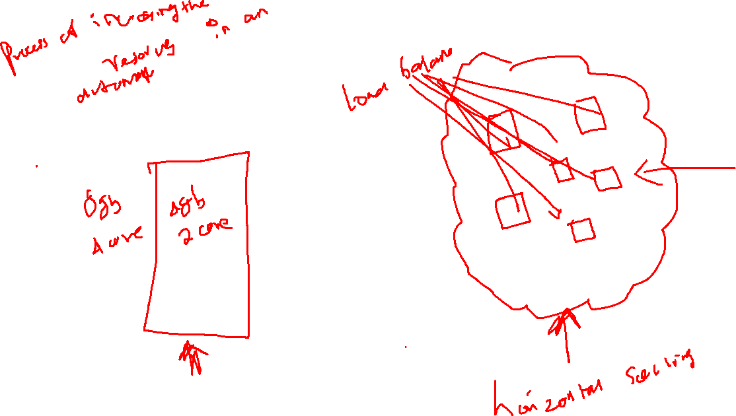

Slide 30
AWS Regions
Edge Locations ->
is the nearest point to the consumer, who is consuming the AWS service. In these locations, server is not present but the small setup I maintain there for provide the cache. They are located in all the major cities around the world
Region –>
they are running the service on multiple regions across the globe, depends on your minimum latency you can select your datacentres and can work
In which regions are AWS Cloud will offer the service?
Availability Zones ->
Data centre available in particular regions, counts may differ depends on regions, you can view the counts on VPC Subnets

Slide 31
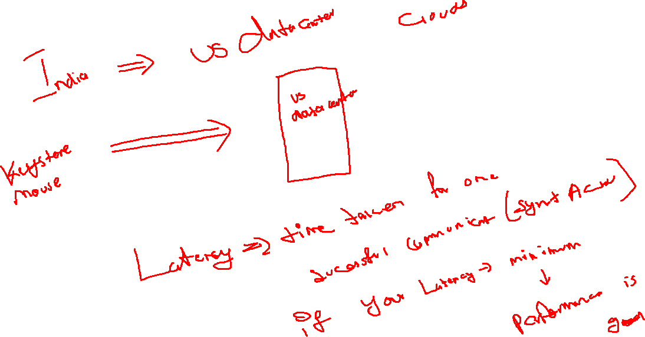

Slide 32
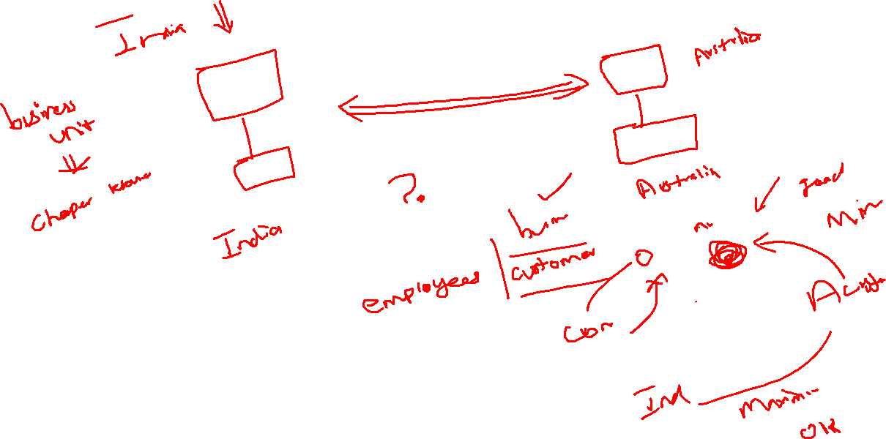

Slide 33
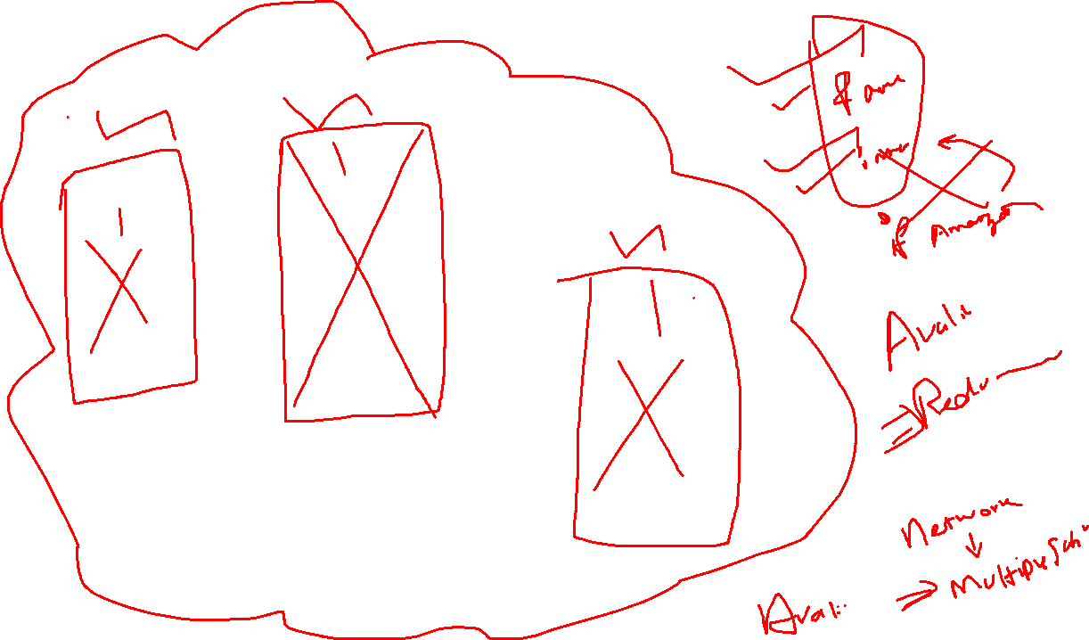

Slide 34
Overview of DW and Data Lake related services, such as, EMR, Glue, Redshift, Athena
Karthick Selvam

Slide 35
Topics
How will you differ Database and Data Warehouse?
Working principle of Database?
Working principle of Data Warehouse?
Differentiate OLAP and OLTP?
What is Data Marts?

Slide 36
Topics
IP address
Types of IP Address
Class available in IPV4
Subnets
Subnetting
How to do the subnetting
Port numbers
List out 20 well known port number and its usuage

